Slide 1
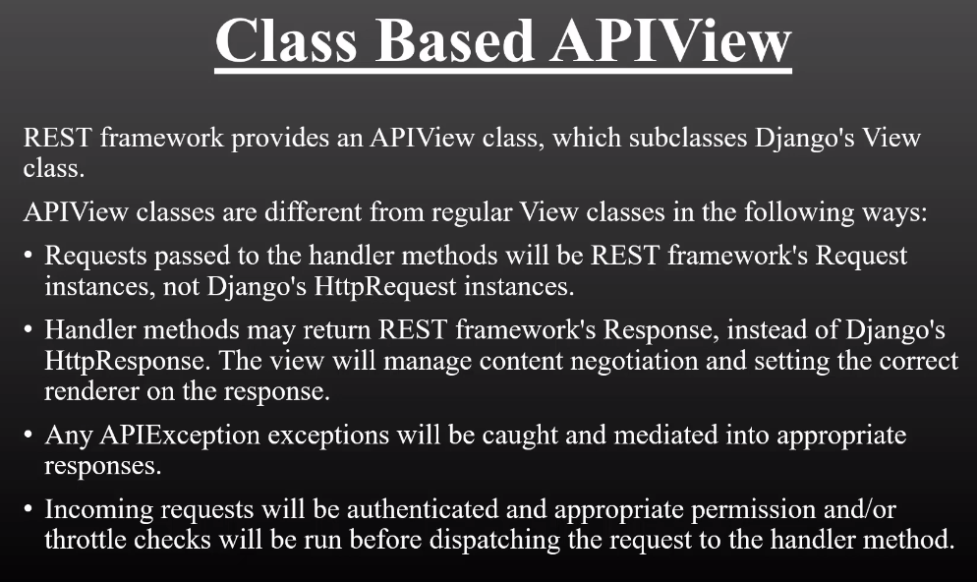
Class Based API VIEW

Slide 2
